Slide 1
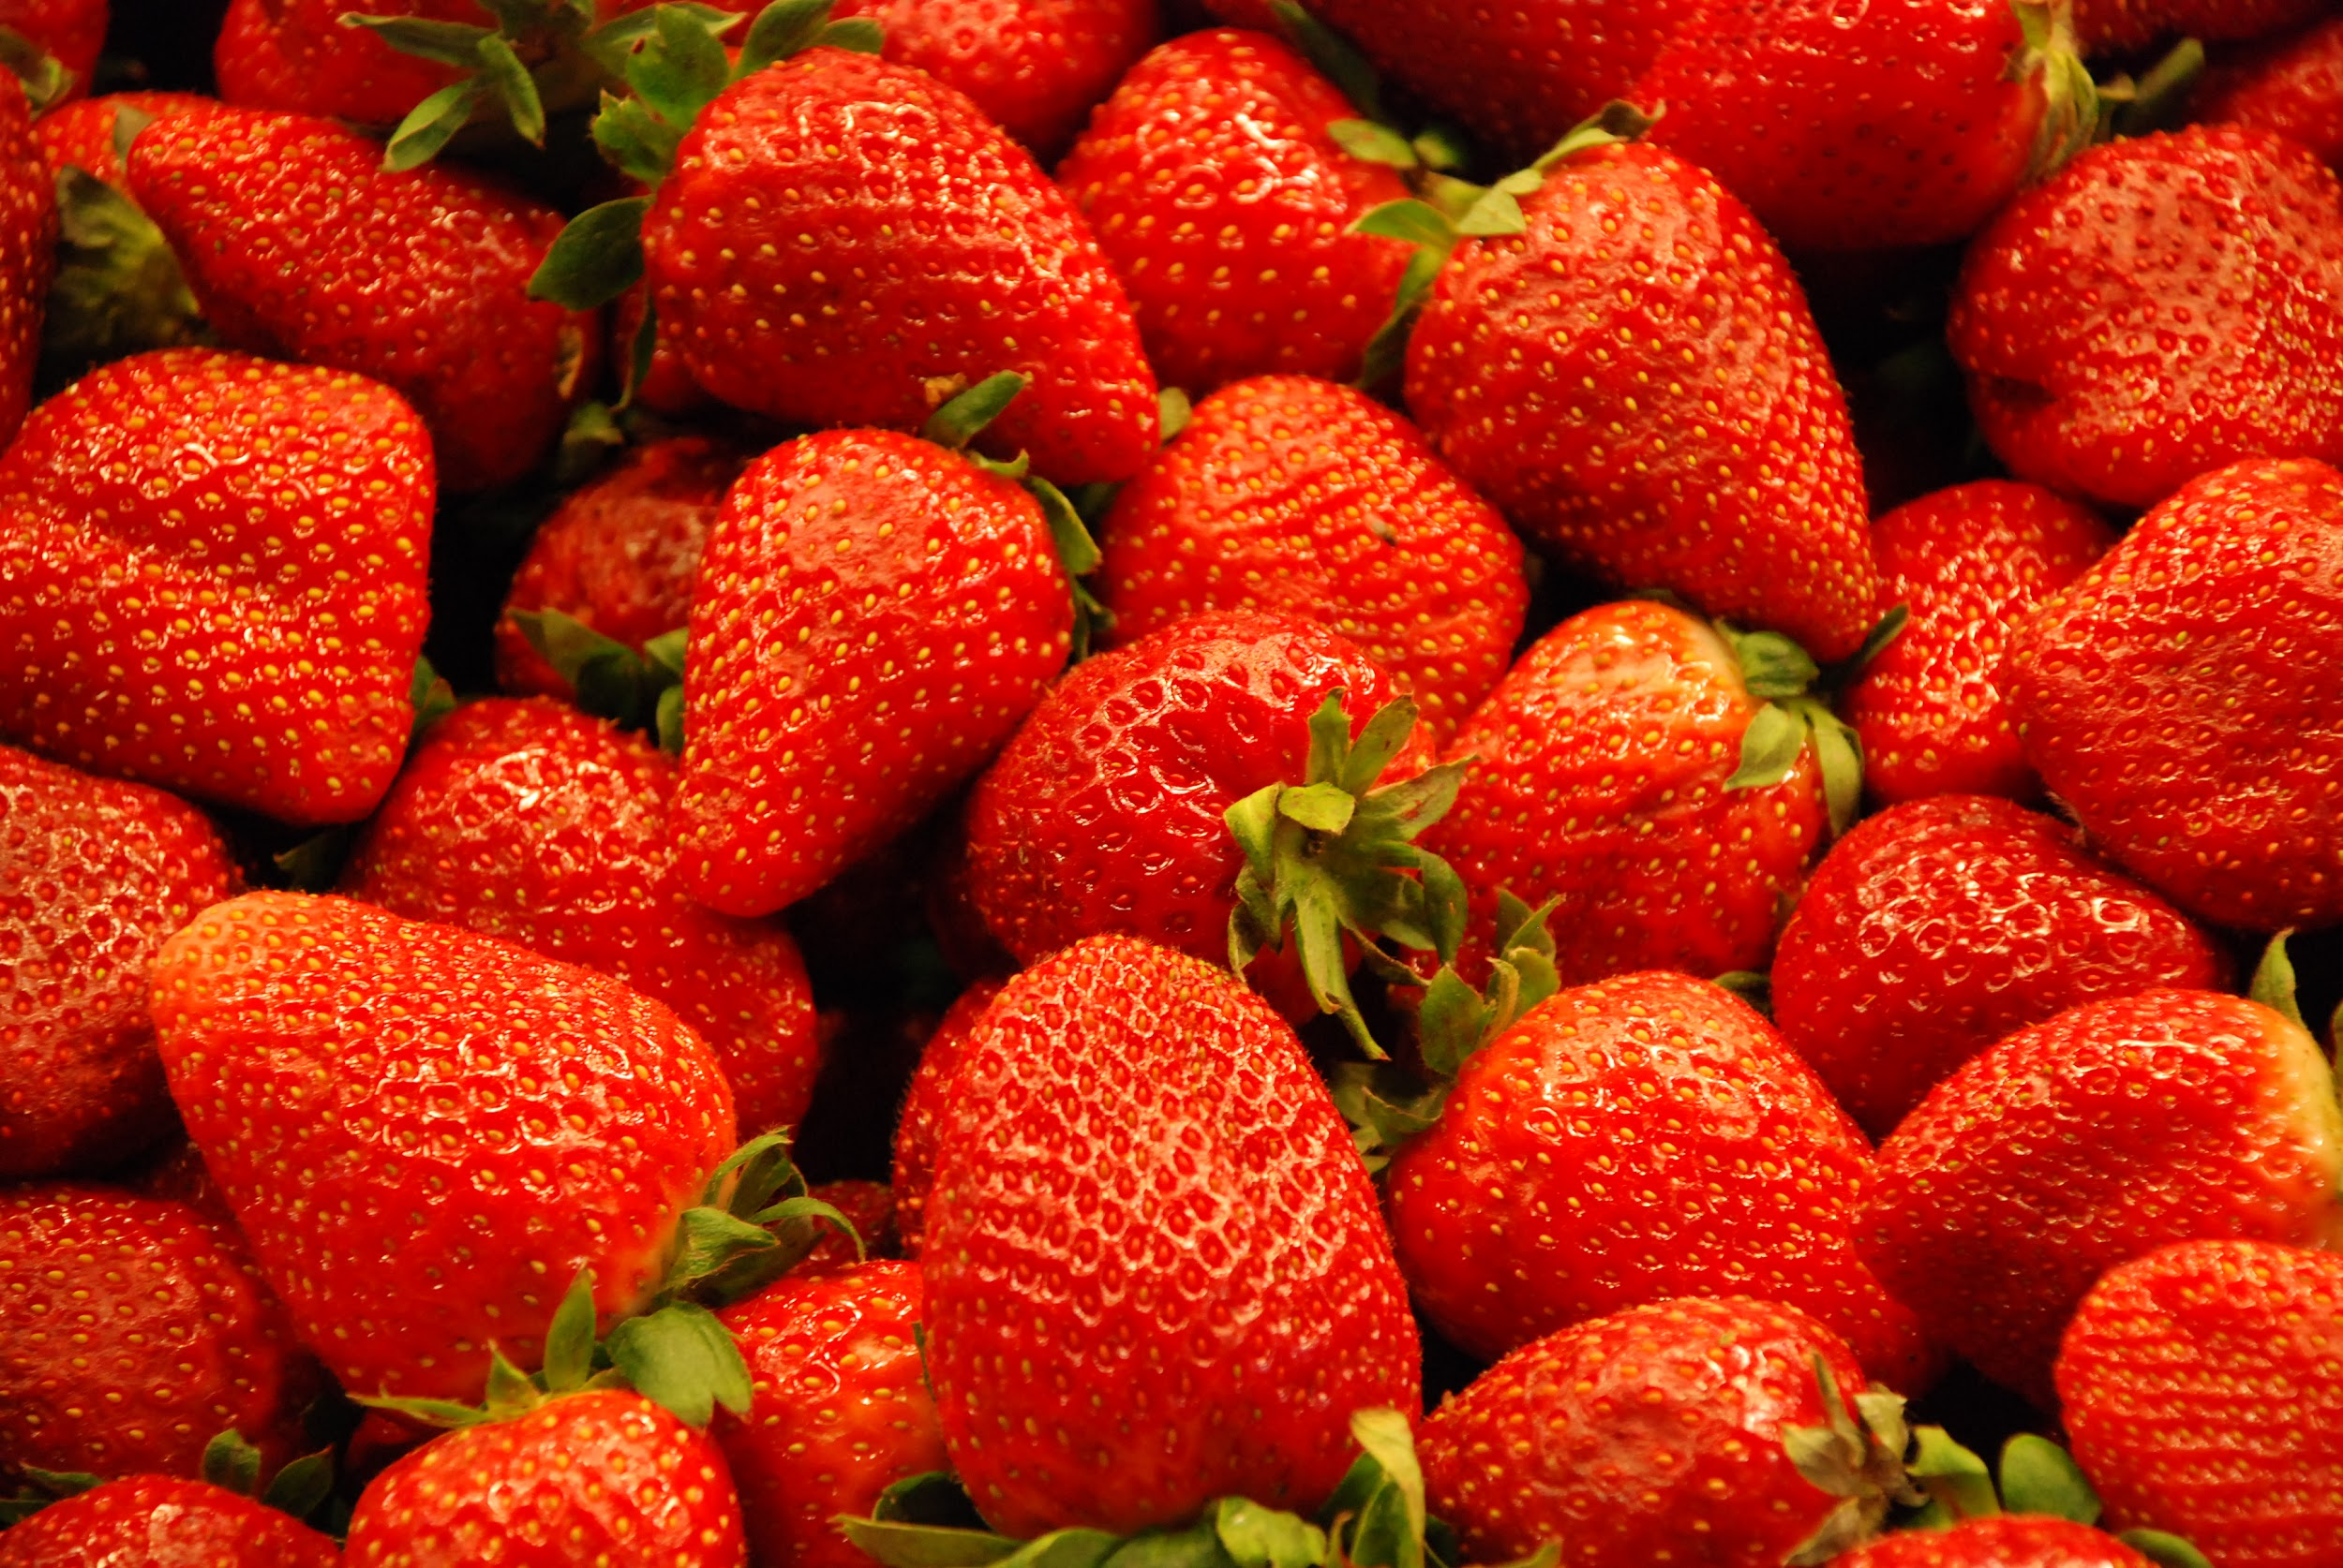
Live,Love,Appreciate Life…. And Strawberries

Slide 2
Drive Cars,Love Cars, Race Cars.

Slide 3
so much depression
Where are you
Leslie McFarlin

Slide 4
Born with Movies
in my Blood

Slide 5
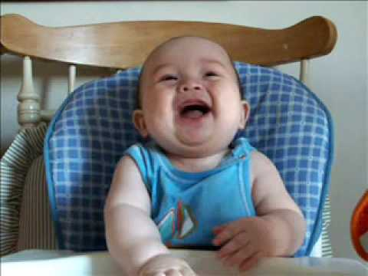
Just tell jokes to keep smiling

Slide 6
Separating myself so I stand out

Slide 7
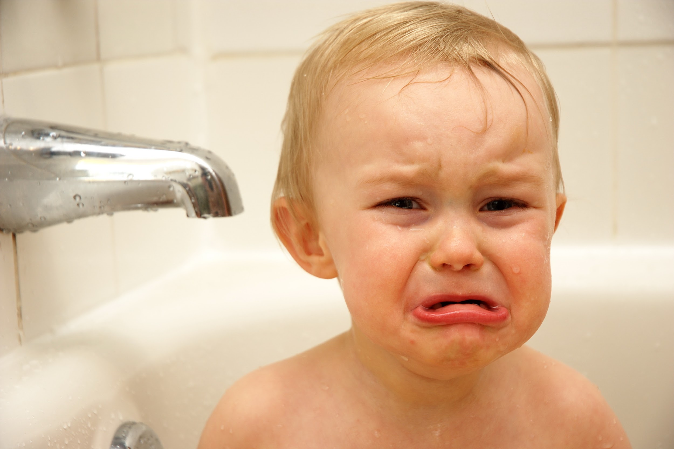
NOTHING WILL EVER
BY: ISSIAH GEESTON
REPLACE MY CANDY

Slide 8
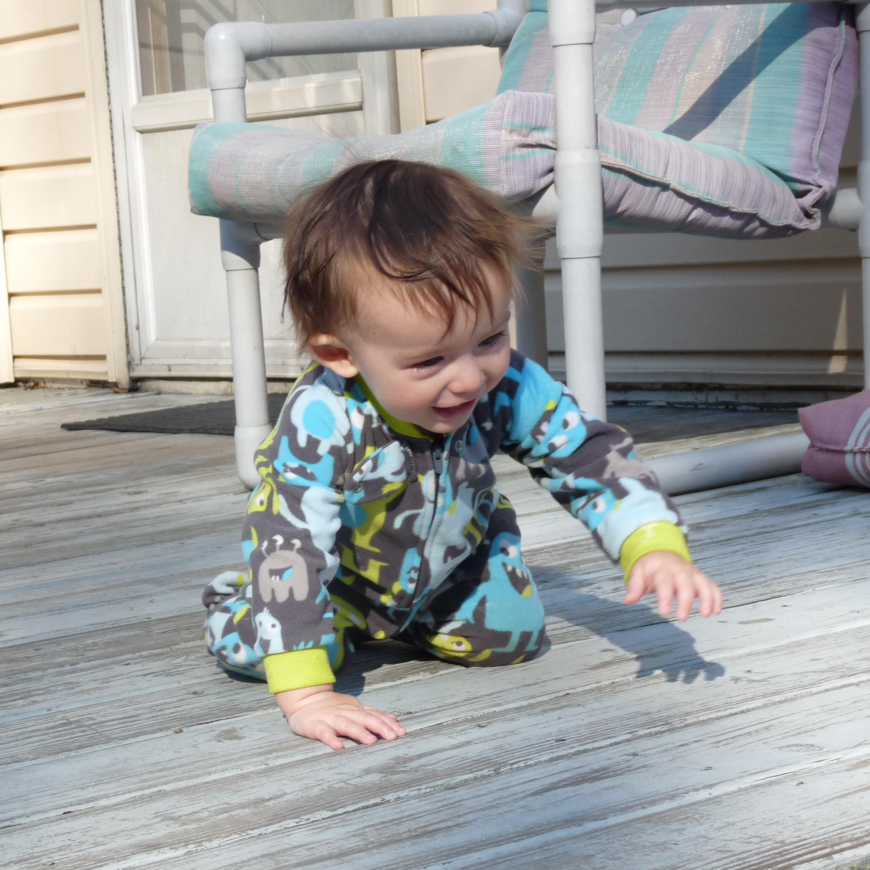
HARD-WORK NEVER COMES FROM QUITTING
BY: ISSIAH GEESTON

Slide 9
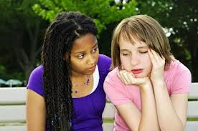
Helpfulness is a part of me.

Slide 10
Hardworking when it comes to life

Slide 11
What you see isn’t always true
Samiayah P.

Slide 12
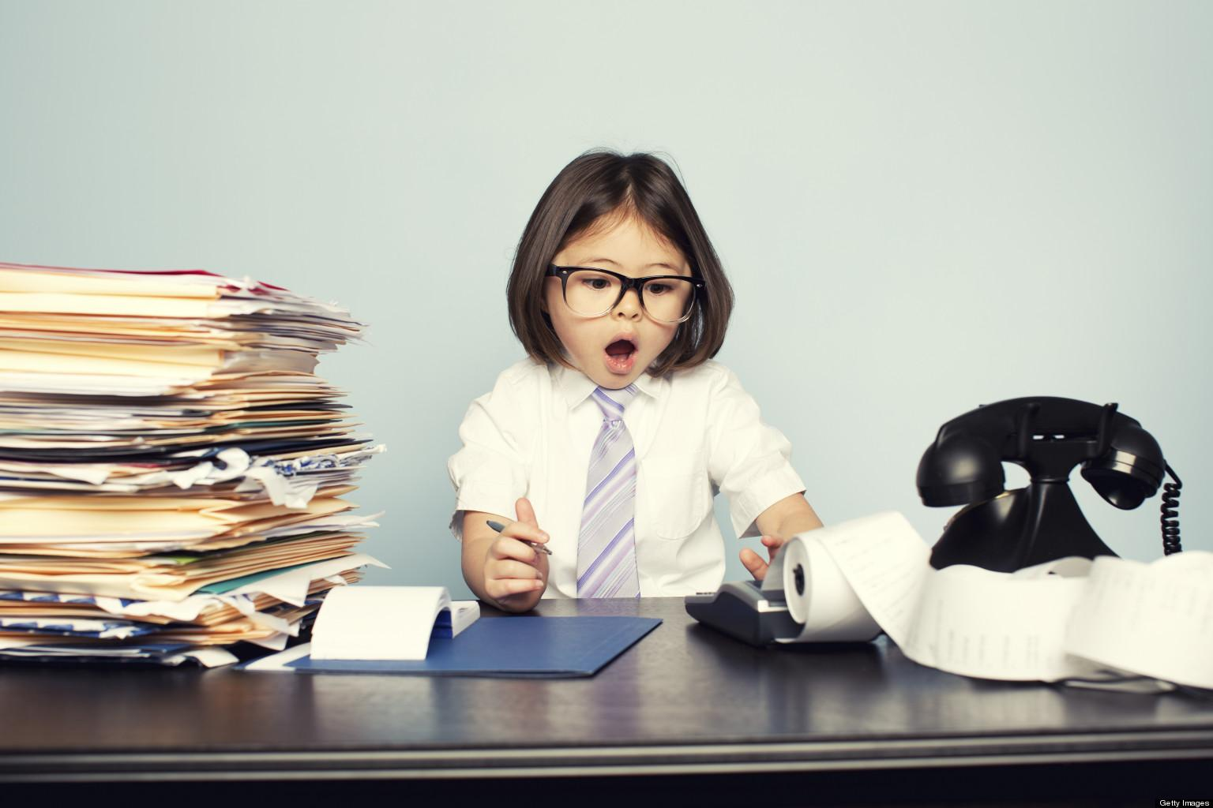
Having to grow up has responsibilities

Slide 13
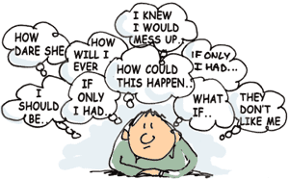
Anxious
About
Things
About
To
Happen
By: Courtney D

Slide 14
scared
of
things
……..
you
can’t
control

Slide 15
Alexus.B
Motivation Keeps The Mind Going Constantly

Slide 16
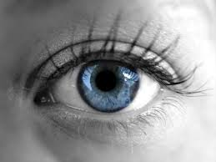
Emotions Don’t Express……..
Being UNFILTERED doesn’t change your PERSONALITY!
Your True Feelings
Alexus B.

